Slide 1

COSC 3P94 • STAGE 4 • FINAL PRESENTATION
EasyRoute
A flight-booking interface designed for clarity and trust.
GROUP 6
Dimple Mistry
Brian Kadji
Krisha Desai
Tanisha Bhayani
Sarisha Kadakia
Instructor: Aws Al Jumaily
April 2026
Notes:
Welcome everyone. We are Group 6 and today we'll walk you through our airline website project. I'm [name], and with me are [names]. Over the next 15 minutes we'll cover our Stage 1 research, our personas, the Stage 2 design, what peer reviewers told us, and what we changed. Then we'll do a 5-minute demo.

Slide 2
AGENDA
What we'll cover today
01
Stage 1 Recap
Research, competitor analysis, and what we learned.
02
Personas & User Goals
Who we designed for and what they needed.
03
Stage 2 Design
Decisions behind our initial Figma prototype.
04
Peer Feedback & Changes
What reviewers told us and how we responded.
05
Live Demo + Q&A
Walk through the final product together.
Group 6 • COSC 3P94 • Airline Website
2 / 13
Notes:
Here's our agenda. We'll keep Stages 1 and 2 brief so we have enough time on the peer feedback and the changes we made in response — that's the part graded most heavily at this stage. We'll finish with a live demo and take your questions.

Slide 3


STAGE 1 • RESEARCH
Defining the problem
We set out to design a flight-booking website that helps people complete a booking with less stress. Our research combined competitor analysis of three airlines with a 46-respondent user survey.
Key requirements we identified
Intuitive, minimal-step booking flow
Clear feedback after every action
Accessibility for users with disabilities
Secure, private payment handling
Tools to view, modify, or cancel bookings
3
46
airlines analyzed
survey responses
Target users
Students, families, business travelers, elderly users, and international travelers.
Group 6 • COSC 3P94 • Airline Website
3 / 13
Notes:
In Stage 1 we studied three airline sites — Air Canada, Saudia, and Emirates — and ran a 46-person survey. The goal was to understand what real users want from a booking site and where existing ones fall short. Our main functional requirements came out of this research: a short, intuitive flow with clear feedback, accessibility baked in, and secure payment.

Slide 4
STAGE 1 • COMPETITOR ANALYSIS
What three airlines taught us
Air Canada
Saudia
Emirates
Feature-complete but dense
Clean flow, visually busy
Best balance we saw
STRENGTHS
STRENGTHS
STRENGTHS
Comprehensive fare breakdown, strong accessibility content, reliable session handling.
Clear step progression, AI assistant, multilingual support, flexible date view.
Progressive disclosure, transparent fare families, strong visual hierarchy.
WEAKNESSES
WEAKNESSES
WEAKNESSES
Results page feels crowded; upselling interrupts flow.
Form-heavy, visually rich backgrounds compete with the task.
Still some optional services to manage, but integrated cleanly.
Group 6 • COSC 3P94 • Airline Website
4 / 13
Notes:
Each airline taught us something different. Air Canada is thorough but dense — you can feel the cognitive load on the results page. Saudia has a clean step-by-step structure but visually busy backgrounds. Emirates was the closest to what we wanted to build: clear hierarchy, progressive disclosure, and transparent fare comparison. Our big takeaway was the banner at the bottom: avoid overload, disclose progressively, and keep price visible throughout.

Slide 5




PERSONAS • PRIMARY
Aisha Patel — the budget-conscious student
Goals
Frustrations
Save money wherever possible
Book quickly under time pressure
Understand total cost before paying
Feel confident in the deal picked
Hidden baggage and seat fees
Aggressive upselling at checkout
Too many fare tiers to compare
Confusing refund policies
Aisha Patel
22 • Business student • Books independently
Why primary
"I just want to see the final price without digging through fare tiers."
She is the most sensitive to complexity and price confusion. Designing for Aisha means the interface stays simple for everyone else too.
Group 6 • COSC 3P94 • Airline Website
5 / 13
Notes:
Our primary persona is Aisha — 22, a business student who books her own flights a few times a year. She's price-sensitive, books under time pressure, and is the user most likely to abandon if she gets overwhelmed. We chose her as primary because if the interface works for Aisha, it works for everyone. She needs speed, cost transparency, and no surprises.

Slide 6

PERSONAS • SECONDARY
Michael Thompson — the organized family planner
Goals
Frustrations
Coordinate seats for the whole family
Clear baggage and cancellation rules
Stress-free planning ahead of time
Review full booking before paying
Re-entering passenger details
Complex seat maps with unclear rules
Unclear baggage pricing
Hard-to-find customer support
Michael Thompson
39 • Marketing manager • Books for family of 4
Why secondary
"I don't mind paying a bit more — I just need to sit with my kids and know what's included."
His needs are supported through progressive disclosure — multi-passenger forms and seat coordination — without overwhelming Aisha's simpler flow.
Group 6 • COSC 3P94 • Airline Website
6 / 13
Notes:
Michael is our secondary persona — a 39-year-old marketing manager booking for a family of four. His needs are more complex: multiple passengers, seats together, clear baggage rules. We don't let those needs dominate the core design; instead, we use progressive disclosure so he can access them when he needs them, without cluttering the interface for Aisha.

Slide 7
WHAT USERS NEED
Designing for two personas, one smooth flow
Aisha's goals
Michael's goals
Shared goals
PRIMARY PERSONA
SECONDARY PERSONA
WHAT EVERYONE WANTS
Start booking immediately
Compare flights easily by price and duration
See total cost up front
Avoid confusion from fare tiers
Skip aggressive upselling
Prevent errors in passenger info
Manage multiple passengers efficiently
Pick seats together for the family
Understand baggage and refund rules
Access support easily if needed
Review the full booking summary
Reduce stress during booking
Avoid information overload
Feel in control of decisions
Trust the system with personal data
Complete booking quickly and confidently
Group 6 • COSC 3P94 • Airline Website
7 / 13
Notes:
These are the concrete goals we designed for. Aisha's column on the left drives the main flow — get in, compare, see the price, check out. Michael's column on the right adds features like multi-passenger input and seat coordination. The shared column on the right is what every user wants: a low-stress, trustworthy booking they can complete quickly.

Slide 8






STAGE 2 • DESIGN DECISIONS
Principles behind our first Figma prototype
Combined search + find booking
Visible progress indicator
Persistent price summary
Both tasks live in one homepage module — our key innovation, shaving clicks for new and returning users.
Search → Flight → Passenger → Seats → Extras → Payment, always shown so users know where they are.
A summary panel stays on-screen throughout the flow to reinforce transparency.
Progressive disclosure
Real airplane seat layout
Minimal promotional content
Fare details and optional services expand only when a user asks for them.
Seat map reflects actual plane geometry, with a legend for availability and type.
Reduced upsell banners to lower cognitive load and keep focus on the task.
Group 6 • COSC 3P94 • Airline Website
8 / 13
Notes:
Here are the six main decisions behind our Stage 2 prototype. Combining search and find-booking into one homepage module was our key innovation — it cuts clicks for both new and returning users. The always-visible progress indicator and persistent price summary directly address the cognitive-load problem we saw on Air Canada. Progressive disclosure came from Emirates. The real airplane seat layout and minimal promotional content round it out.

Slide 9
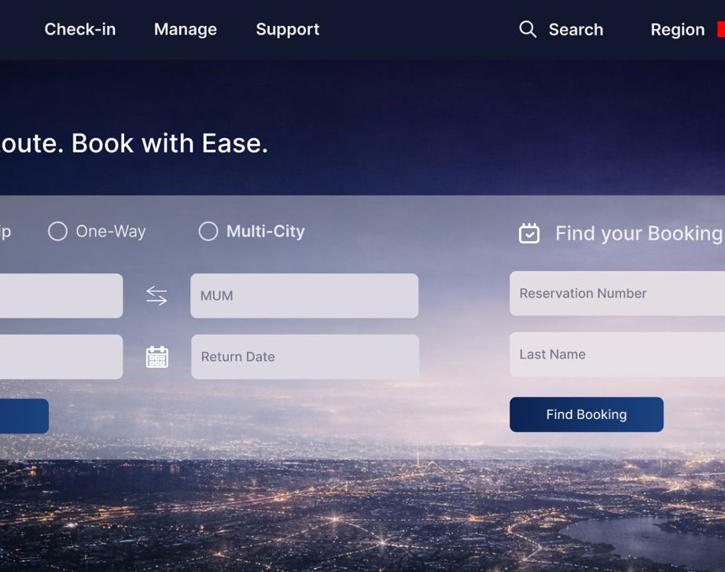
S T A G E 2 • D E S I G N D E C I S I O N S ​
Design System & Visual Identity
Key Design Decisions
Dark Navy Header
EasyRoute branding with Check-in, Manage, Support, Search, Region, Login
Featured Destinations
Mumbai $1,200 · Dubai $860 · London $1,150
EasyPoints Rewards
Earn points on every flight, redeem for upgrades & perks
Flight Search Options
Round-Trip, One-Way, Multi-City with airport code inputs
BRANDED LOADING SCREEN
"Finding the best routes for you..."
Transparent Pricing
Fast & Simple Booking
Flexible & Secure
EasyRoute
Check-in
Manage
Support
|
🇨🇦 EN
Login

Slide 10

STAGE 2 • USER FLOW
How a booking moves through our prototype
1
2
3
4
5
6
Search
Select Flight
Choose Fare
Passenger & Payment
Seats
Confirmation
Pick trip type, route, dates, passengers.
Browse different flight options.
Select fare type based on user preference.
Enter passenger info and payment info
Select seat accroding to preference
Review + confirmation screen.
What makes this flow different
The progress bar is always visible, the price summary stays on the right, and optional steps (seats, extras) can be skipped without losing context. Users never feel trapped in a funnel.
Group 6 • COSC 3P94 • Airline Website
9 / 13
Notes:
This is the full user flow: six numbered steps from search to payment. The progress bar stays visible so users always know where they are. The price summary follows them down the right side. Seats and Extras are optional — users can skip them without losing progress. That's the important part: the flow never traps the user.

Slide 11


STAGE 3 • PEER FEEDBACK
Themes from the critiques we received
After Stage 2, other groups reviewed our prototype and highlighted four recurring areas for improvement. We grouped their feedback into themes before deciding what to change.
Visual design
Navigation
Interface felt grey and text-heavy. Low contrast made it hard to find the important elements on each page.
No back button in the flow. Progress-bar steps were not directly clickable, and Edit Search did not always restore previous inputs.
Missing features
Content
No login confirmation screen, and limited help/support surfaces throughout the flow.
remove duplication, correct spelling mistakes, add missing content ()pages.
Group 6 • COSC 3P94 • Airline Website
10 / 13
Notes:
After Stage 2 we got peer critiques that clustered into four themes. Visual design: the palette was too grey and hierarchy was weak. Navigation: no back button, and the progress steps weren't directly clickable. Missing features: no confirmation screen, no loyalty program. Responsiveness: layout didn't scale to smaller screens. We took all four seriously.

Slide 12
WHAT WE CHANGED
From feedback to final product
FEEDBACK
OUR CHANGE
Navigation was confusing — users couldn't return to seat selection from later steps, page names were unclear, and there was no login validation.
Reworked the booking flow so users can go back to the seat selection page from passenger details & payment; renamed pages to remove confusion; added login validation with a success overlay when the user signs in.
Visual design felt flat — overlays, input fields, and labels lacked polish, and the interface had no motion or feedback on interaction.
Redesigned overlays, input fields, and labels; added animations and hover states for a more responsive, polished feel.
Interactive elements didn't behave as expected — radio buttons didn't show a selected state, and some elements weren't clickable.
Fixed radio button selected states and made previously static elements clickable.
Content had duplicated sections, spelling mistakes, and missing information.
Removed duplicated content, corrected spelling errors, and added the missing information.
Group 6 • COSC 3P94 • Airline Website
11 / 13
Notes:
This is the most important slide: feedback on the left, what we actually changed on the right. We rebuilt the color palette for better contrast. We added a persistent back button and made every progress-bar step clickable. We added a confirmation screen after payment. We made the trip-type toggle actually update the form. We rebuilt layouts with responsive breakpoints. And we added a Help Centre link plus a rewards preview. Six concrete changes tied directly to what reviewers told us.

Slide 13

Live Demo
Let's walk through the final product end-to-end.
1. Homepage search
2. Flight selection
3. Passenger info & payment
4. Seat map
5. Confirmation
Notes:
That's the walkthrough. Now let's switch to the live demo. We'll start on the homepage, do a search, pick a flight, enter passenger info, choose seats, and finish at the confirmation screen. About five minutes, then we open it up for questions.

Slide 14
THANK YOU
Questions?
We'd love to hear your feedback.
GROUP 6
Dimple Mistry • Brian Kadji • Krisha Desai • Tanisha Bhayani • Sarisha Kadakia
COSC 3P94 Introduction to Human-Computer Interaction • Instructor: Aws Al Jumaily
Notes:
Thank you all. Happy to take any questions — about the research, the design choices, the changes we made, or anything you saw in the demo.

